Slide 1
KEYLOGGER & SECURITY
NAME : ASHWINI.S
DEPT : BE.CSE
YEAR : lll
REG NO : 511821104006

Slide 2

KEYLOGGERS:

Slide 3
KEYLOGGERS:
A key logger is program that runs in the background or hardware , recording all the keyst PIG.
Once keystrokes are logged , they are hidden in machine for later retrieval, or shipped raw to the attacker.
Attacker checks files carefully in the hopes of either finding passwords , or possibly other useful information.

Slide 4
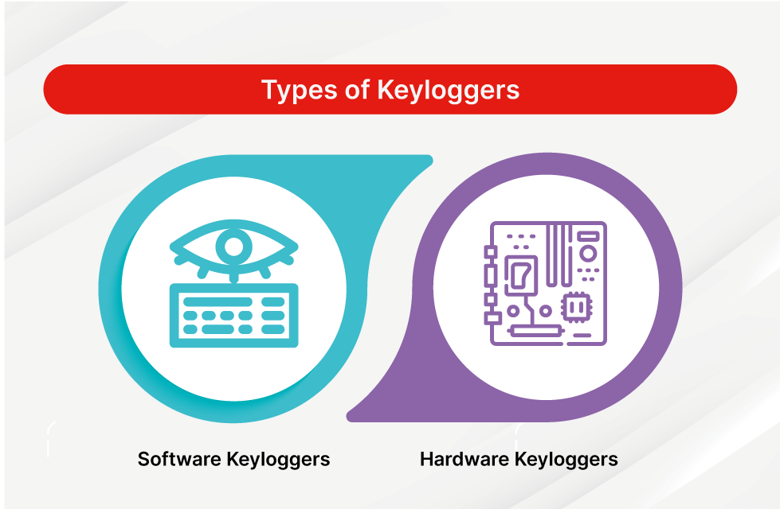
TYPES OF KEYLOGGERS:

Slide 5
HARDWARE KEYLOGGER
Hardware key loggers are used for keystroke logging , a method of capturing and recording computer user’s keystrokes , including sensitive passwords.
Generally, recorded data is retrieved by typing a special password into a computer text editor.
The hardware key loggers plugged in between the keyboard and computer detects that the password has been typed and then presents the computer with “typed” data to produce a menu.

Slide 6
HARDWARE TYPES:
Comes into three types.
1. Inline devices that are attached to the keyboard cable.
2. Devices which can be installed inside standard keyboards.
3. Replacement keyboards that contain the key logger already built-in.

Slide 7
ADVANTAGES & DISADVANTAGES OF HARDWARE KEYLOGGER:
Advantages:
1. Antivirus techniques cannot catch these.
2.Work on all computing platforms.
Disadvantages:
1. It can be spotted by a suspicious user.

Slide 8
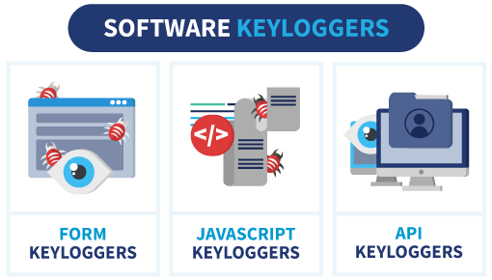
SOFTWARE KEYLOGGER

Slide 9
Software key logger:
Software key logger track system , collect keystroke data within the target operating.
System , store them on disk or in remote location and send them to the attacker who installed the key loggers.
Anti malware , personal firewall , and Host-base intrusion prevention solution detect and remove application key loggers.

Slide 10
SOFTWARE KEYLOGGER DETECTION METHODS INCLUDE:
Scan local drive for log.txt or other log file associate with known key loggers.
Implement solution that detect unauthorized file transfer via FTP or other protocols.
Scan content sent via email or other authorized me looking for sensitive information.
Detect encrypted files transmitted to questionable destinations.

Slide 11
ADVANTAGES & DISADVANTAGES OF SOFTWARE KEYLOGGER
Advantages:
1. Are hard to detect.
2.Can be deployed remotely via a software vulnerability attack.
3. Are fairly easy to write.
Disadvantages:
1. A good antivirus scheme could sniff these out.
2. For fewer cons with the software , so these are much.

Slide 12
SPYWARE:
Application that send information from your computer to the creator of the Spyware.
Sometimes consists of an apparent core functionality and hidden functionality of information gathering.
Can be used by websites for marketing information,to determine the stance with regard to competitors and market.

Slide 13
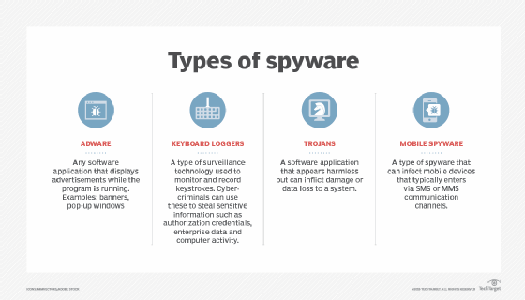
TYPES OF SPYWARE:

Slide 14
SPYWARE VS TROJAN HORSE:
Spyware programs are sometimes installed as Trojan horses of one sort or another . They differ in that their creators present themselves openly as businesses , for instance by selling advertising space on the pop-ups created by the malware. Most such programs present the user with an End-User License Agreement which purportedly protects the creator from prosecution under computer contaminant laws. However , spyware EULAs have not yet been upheld in court.

Slide 15
SPYBOTS:
Spy bot are the prototypical example of “spyware” . A spy bot monitors a user’s behavior , collecting logs of activity and transmitting them to third parties.
A spy bot may be installed as a browser helper object , it may exist as a DLL on the host computer , it may run as a separate process launched whenever the host OS bots.

Slide 16
TRACKING COOKIES:
Cookies that can track your web
Activities
May include cookies that contain
user names
passwords
Other private information that you enter on web sites(SSN , banking info, credit cards)

Slide 17
FUTURE SCOPE:
Emails.
Banking info.
Sensitive enterprise data.
Personality identifiable information.
Etc.

Slide 18
CONCLUSION:
Key loggers are a potent threat to both individuals and enterprise , with the potential to cause significant harm if left undetected.
Understanding the nature of key loggers , their methods of infiltration , and the dangers they pose is crucial for maintaining a secure digital environment.

Slide 19
REFERENCES:
https://www.ntiva.com/cyber-security-services/
Geeksforgeeks.org/cryptography-introduction/
https://sec.okta.com/articles/2020/12/password-spraying-attacks-and-how-prevent-them
https://searchsecurity.techtarget.com/definition/keylogger
https://www.veracode.com/security/keylogger
Chrome,Google,Books,Libraries,etc….

Slide 20
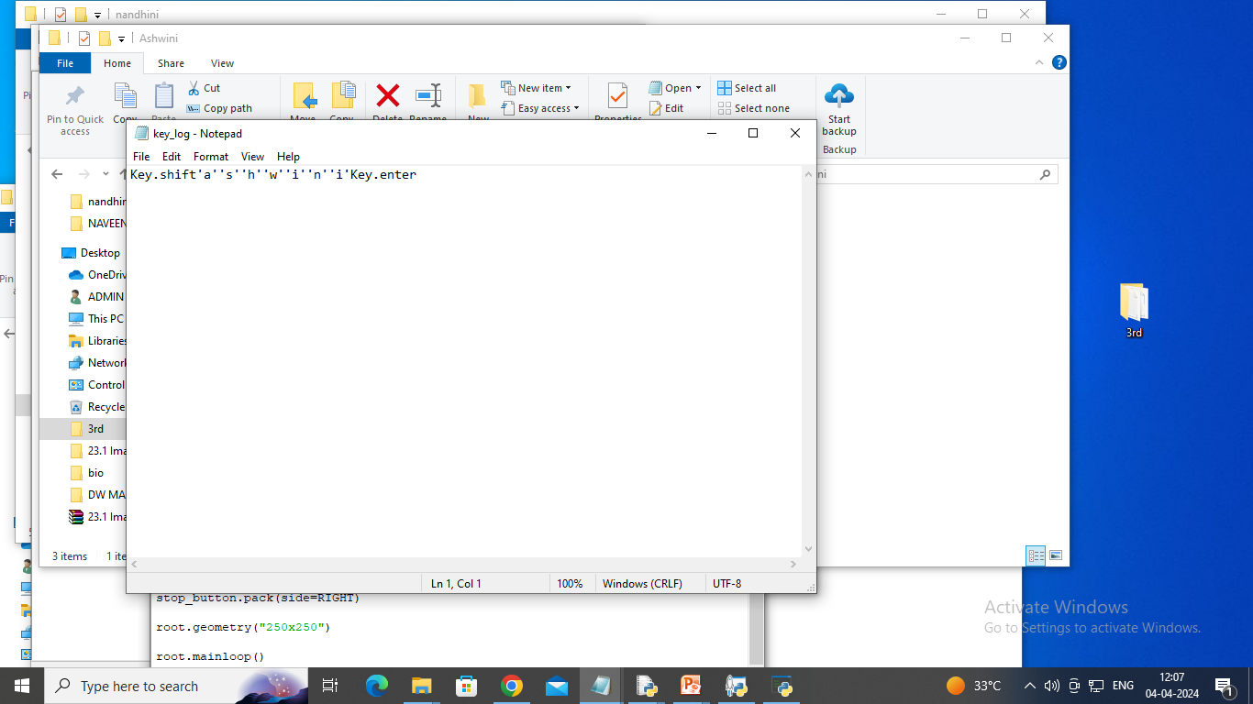

Slide 21
THANK YOU

